Slide 1
Theme 3. Psychoacoustics

Slide 2
Intro
Types of hardware and software implementation of digital sound and speech processing systems are determined by their initial characteristics, features of auditory perception and requirements for playback quality.
Speech information is fundamentally different in its physical parameters from sound information containing a combination of voice data with musical accompaniment
Features and differences of speech and sound information are used in their digital processing and compression
A human receives basic information about sound vibrations in the frequency range up to about 4 kHz, frequencies determine the intelligibility and clarity of audio information.
The spectral composition of speech occupies a frequency band from about 50 to 7000-10000 Hz
In analog telephony, a frequency band of 0.3-3.4 kHz is used, which worsens the perception of a number of sounds (for example, hissing), but practically does not affect speech intelligibility

Slide 3
Intro
The idea of ​​converting to digital form not the speech signal itself, but its parameters (the number of zero crossings, spectral characteristics, etc.), in order to simulate the model of the vocal tract and synthesize the original signal based on these parameters, lies at the core of synthesizing codecs or vocoders.
Working principle of hybrid codecs is based on a coding model with linear prediction and an algebraic code book, while analyzing the speech signal and extracting model parameters (linear prediction system coefficients, indices and gain factors in adaptive and fixed code books), then these parameters are encoded and transmitted to the channel
The human hearing tract distinguishes the frequency components of sound approximately in the range from 30 Hz to 20 kHz; the upper limit may differ slightly depending on the age of the person, the conditions for reproducing information, etc.

Slide 4
Intro
To significantly reduce the redundancy of audio information, various methods of linear and non-linear processing of audio signals are used, which lead to lossy compression that reduces the size of the encoded sequence compared to the original by removing information that is not perceived by a person; lossy compression technology turns the lack of human hearing into an advantage, discarding "unnecessary" information; a compromise between a low bit rate and the quality of the reproduced audio signal is achieved by changing the amount of information discarded
Additional problems in coding audio information arise when processing various formats - from a stereo signal to a surround multichannel audio signal; in these cases, to significantly reduce the redundancy of multichannel signals, correlations between them are used

Slide 5
Common audio characteristics
interference - amplification of sound vibrations at some points in space and weakening of vibrations at other points as a result of the superposition of two or more sound waves
refraction - change in the direction of movement of a sound wave from the border with another environment
reverberation - reflections of sound vibrations in a confined space, causing a specific hum, changing the timbre, saturation, depth of the perceived sound
diffraction - the ability of sound waves to bend around obstacles
echo - time-shifted and separately distinguishable repetitions of short-term sound vibrations
resonance effect - the ability of a sound wave created by some oscillating body to transfer the energy of vibrations to another body, which, absorbing this energy, becomes a sound source itself
diffuseness index - the factor of isotropy and homogeneity of the sound field
sound pressure - a characteristic of the volume of sound directly perceived by the human ear
Doppler effect - a change in the length of sound waves with a change in the relative to the sound source speed of the listener

Slide 6
Common audio characteristics
The analog representation of audio signals is based on the similarity of the shapes and basic characteristics of their corresponding electrical signals.
In terms of information theory, the amount of information in the electrical signal is exactly equal to the amount of information in the original signal, and the electrical representation does not contain redundancy that could protect the transferred signal from distortion during storage, transmission and amplification.
An audio signal or its electrical equivalent u(t) is usually considered a random process with a distribution of instantaneous values, which is characterized by a certain probability density W(u)

Slide 7

Electric equivalent
The level of the electrical equivalent of an audio signal is usually depicted by the voltage generated at the output of a quasi-peak detector with a small charge time constant (order of 5-10 ms) and a significant value of the discharge time constant τ (1-2 s)
The ratio of the average value of the rectified instantaneous values ​​of the signal U(t, τ) at the output of the quasi-peak detector (or the signal power P(t, τ)) to some conditional value U₀ (or P₀) is determined by the formula:
U₀ is the root-mean-square value of the electrical signal with an effective voltage of 0.775 V at a load of 600 Ohms (released power - P₀ = 1 mW) taken as the reference point; expressed in decibels, this value determines the level value equal to 0 dB

Slide 8
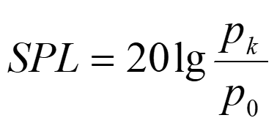
Sound intensity (sound pressure)
Sound intensity or sound pressure is estimated either in Pascals or in decibels relative to a certain threshold, the value of which is taken equal to p₀ = 2*10⁻⁵ Pa = 20 μPa and corresponds to the hearing threshold of a healthy young person in the sound frequency range of 1-4 kHz
To characterize sound pressure levels (SPL), the following equation is used:
p₀ and p_{k} - sound pressure, expressed, for example, in Pascals

Slide 9
Sound intensity (sound pressure)
Sound source | Sound pressure, Pa | Sound pressure level, dB
Hearing threshold | 2•10⁻⁵ | 0
The rustle of leaves, a gentle wind, calm breathing, the ticking of a watch | 6•10⁻⁵ – 6•10⁻⁴ | 10 – 30
Noise in the room, quiet conversation, drunken violin, quiet music | 6•10⁻⁴ – 6•10⁻³ | 30 – 50
Medium conversation, TV sound, shop noise, restaurant noise | 6•10⁻³ – 2•10⁻² | 40 – 60
Loud conversation, car, noisy street, noise in the typing office | 2•10⁻² – 2•10⁻¹ | 60 – 80
Truck, traffic on a busy highway, noise of the subway train, car repair shop | 2•10⁻¹ – 6•10⁻¹ | 80 – 90
Female and male singing | 6•10⁻³ – 6•10⁻¹ | 40 – 90
Variety and symphony orchestras | 2•10⁻² – 6 | 40 – 110
Loud disco, air hammer, plane taking off, blacksmith shop | 2 – 20 | 100 – 120
Jet plane from a distance | 6 – 200 | 110 – 140
Pain treshold | 60 | 130

Slide 10
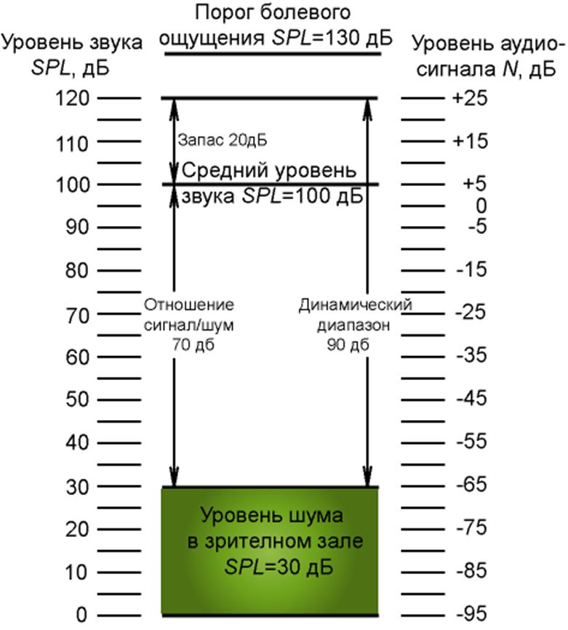
Sound intensity (sound pressure)
Sound system electrical equivalent levels (N, dB) are proportional to sound pressure levels (SPL, dB)
At SPL=120 dB at the input of the sound-to-electrical equivalent converter, the maximum level of the electrical signal can reach N=+25 dB
The correspondence of these values ​​is shown in the figure (there is a linear relationship between the SPL and N values, if the system does not apply compression, equalization, clipping or cutoff of signals)
This ratio is typical for broadcasting systems of any type, sound amplification, sound recording
The dynamic range requirements of a sound system depend on its purpose and area of ​​use.
The dynamic range of the system in a soundproof recording studio can be large, since in this case the noise does not exceed 10 - 15 dB
A sound system designed to amplify symphonic music should have a dynamic range margin of more than 20 dB, since the peak values ​​corresponding to the sounds of some instruments (timpani, violins, etc.) can reach 120 dB
In systems designed only to reproduce speech or warning signals, the sound level can be controlled and kept within a very narrow range.
Pain threshold
SPL = 130 dB
SPL, dB
Signal level N, dB
20 dB reserved
Avg. sound
level SPL = 100 dB
SNR = 70 dB
Dynamic range 90 dB
noise level in the auditorium
SPL=30 dB

Slide 11



Spectral characteristics of audio signals
Real sound signals are almost impossible to describe by any mathematical function or empirical dependence. For this reason only time-limited fragments of the audio signal, limited by some window function, are analyzed. In this case, the concept of instantaneous spectrum is used:
where u(t) is the electrical equivalent of the sound signal, w(t) is the window function which is equal to zero outside the specified interval -τ/2 ≤ t ≤ τ/2, f is the current frequency
The power spectral density of an audio signal is often estimated using a narrow-band filter with a bandwidth of Δf:
The result of the spectral analysis is expressed in decibels (G₀ is the value corresponding to zero):

Slide 12
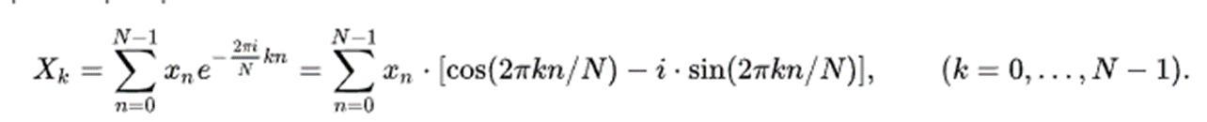
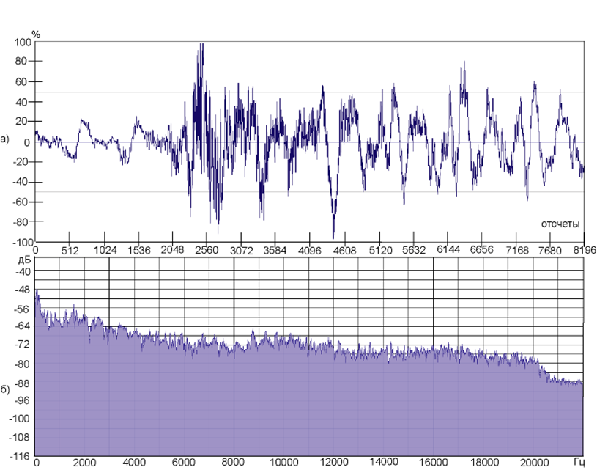
Spectral characteristics of audio signals
To calculate the frequency spectrum of a signal limited in duration and represented by its discrete values, the discrete Fourier transform (DFT) is used
or its variation - Fast Fourier Transform (FFT)

Slide 13
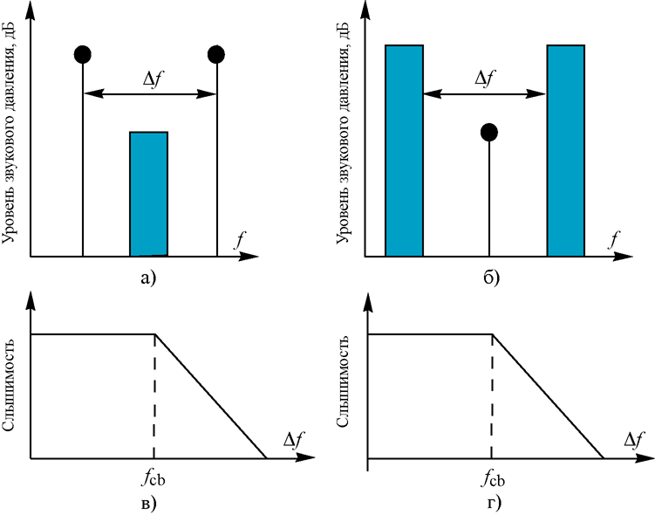
Critical bands
A specific feature of sound perception is the division of sound spectrum into bands of equal intelligibility (critical bands), when the signal within the same band creates very close auditory sensations (different parts in the cochlea of the inner ear are "tuned" to different frequency bands)
Experimentally, the width of the critical band can be determined by a sharp decrease in subjective loudness
Methods for measuring the critical band:
(a, c) the narrowband noise component is masked by two tonal components, the detection threshold of the noise component decreases sharply when the frequency difference of the tonal components is outside the critical band
(b, d) tonal and noise components change roles
Sound pressure level, dB
Sound pressure level, dB
a
b
audibility
audibility
c
d

Slide 14
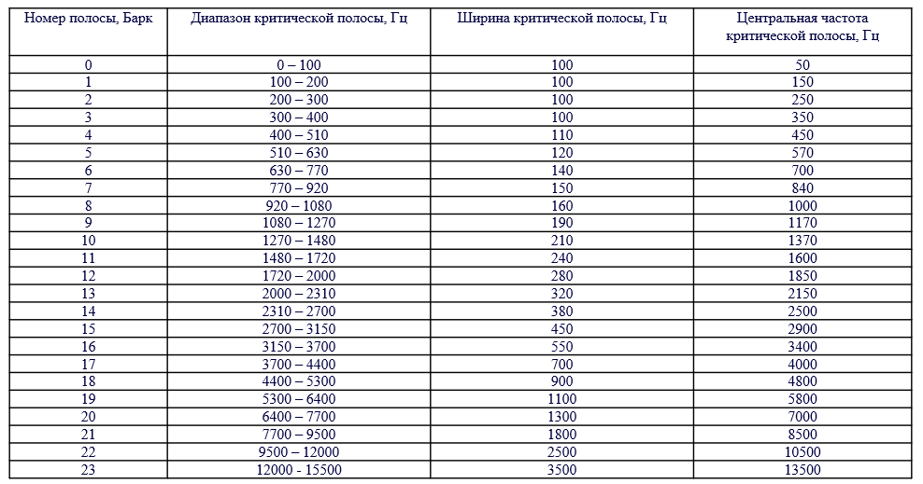
Critical bands
In the frequency range from 0 to 16 kHz, 24 bands are experimentally determined, estimated in Barks (Barkhausen G.G., 1881-1956)
Band #
Critical band range, Hz
Bandwidth, Hz
Central frequency, Hz

Slide 15

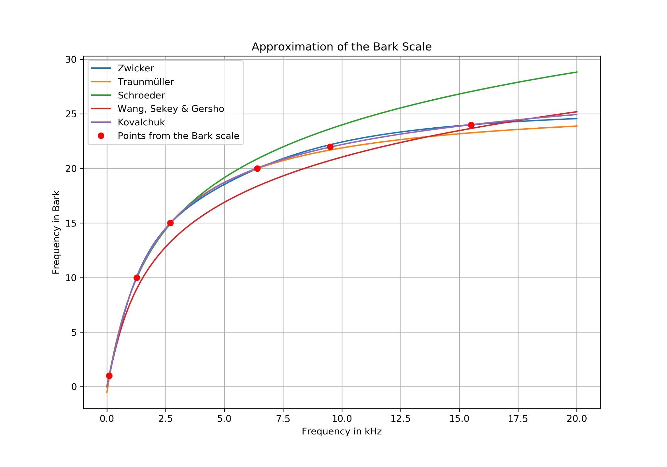
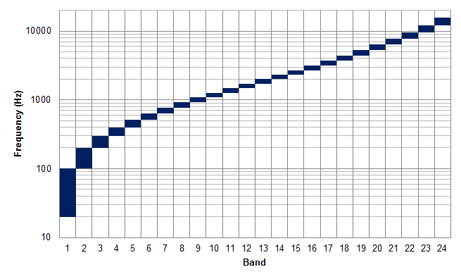
Critical bands
The width of the critical band remains approximately constant (about 100 Hz) up to the center frequency of the band of 500 Hz, and at higher values it increases by an average of 20% of the center frequency
In works on psychoacoustics, the following approximations are used:
Although the function is continuous, for practical purposes it is better to use a discrete bandpass filter bank covering the entire operating frequency band.

Slide 16
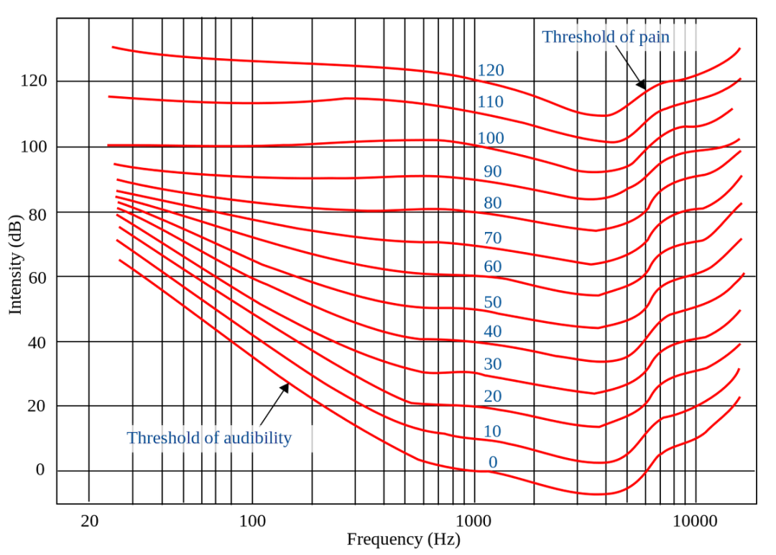
Equal-loudness contour (Fletcher-Munson curves)
One of the most important characteristics of sound perception is loudness, which characterizes the intensity of a sound event.
Loudness is a characteristic of subjective perception, which, in addition to the amplitude of the sound wave, is influenced by various other factors.
Loudness is perceived differently depending on the frequency of the sound.
This fact was first established by two researchers, Fletcher and Munson, who developed a set of graphs called equal loudness curves, or Fletcher-Munson curves.
Each curve on this graph characterizes the level of equal loudness with an initial reference point at a frequency of 1000 Hz

Slide 17
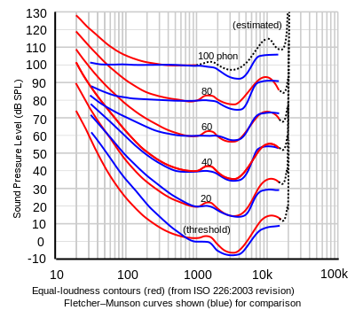
Equal-loudness contour (Fletcher-Munson curves)
Equal loudness curves (isophons) were obtained by scientists Fletcher and Munson as a result of processing data from a large number of experiments they conducted among several hundred visitors to the 1931 World's Fair in New York.
At present, the international standard ISO 226 (1987) accepts the revised measurement data obtained in 1956
Isophones are plots of sound pressure level versus frequency at a given volume level
Phon - a unit for estimating the level of sound volume
Using these curves, you can determine the volume level of a pure tone of any frequency, knowing the level of sound pressure it creates.
The lowest curve roughly corresponds to 3 phon loudness and describes the absolute hearing threshold (AHT[1000 Hz] = 3.369 dB SPL)
Equal loudness curves show how much difference in sound pressure level is required for all frequencies to be heard at the same loudness as a reference 1 kHz sine wave.
The numbers above each curve represent a measure of loudness expressed in phons, at a reference frequency of 1 kHz phons are equal to decibels, i.e. for a pure tone with a frequency of 1 kHz the level in phons is numerically equal to the sound pressure level in decibels
For example, at a very low volume level of 30 phon (30 dB SPL at 1 kHz), a 50 Hz bass tone must be played at 60 dB SPL to be perceived at the same volume as a 30 dB SPL sound at 1 kHz, because the human ear is less sensitive in the low and high frequencies than in the middle frequencies

Slide 18
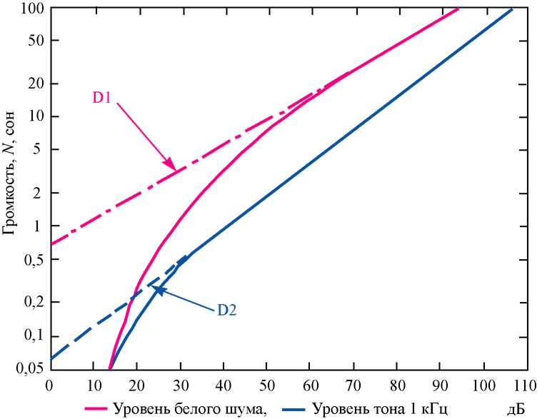
Sones
Volume level can also be measured in sones
The advantage of evaluating levels in sones is that for sound from several components that are widely spaced in frequency, the total loudness level in sones is equal to the sum of the levels of each of the components
There is an unambiguous relationship between the volume levels of pure tonal sound in sones and phones
In fig. shows the dependence of the loudness level in sones of a 1 kHz tone sound (solid line) and white noise (dotted line) on the sound pressure level
1 sone corresponds to the volume of a pure tone frequency of 1000 Hz with a level of 40 dB
When the volume level is increased by 10 phons, the sound volume in sones increases by 2 times, which means that volume levels of 40, 50 and 60 phons correspond to volumes of 1, 2 and 4 sones.
At levels below 40 phons, the level change in sones is much faster, level 3 phon (the absolute threshold of hearing) is 0 sone
Sones
White noise level
1 kHz tone level
dB

Slide 19


Sones
When conducting experiments on the subjective assessment of the loudness level for white noise, the sound pressure level of the reference sound with a frequency of 1000 Hz was set, then the subject was asked to listen to white noise and adjust its level so that it seemed equal to the loud reference
If we agree that after adjusting the white noise and the reference tonal sound, the loudness levels in sones are the same, then we get the dependence of the loudness level of white noise in sones on the sound pressure level, which is shown by the red line in picture
This picture also shows that at high volume the level of the reference sound in sones is proportional to the intensity to the power of 0.3, and the volume level of white noise is proportional to the power of 0.23
Sones
White noise level
1 kHz tone level
dB

Slide 20
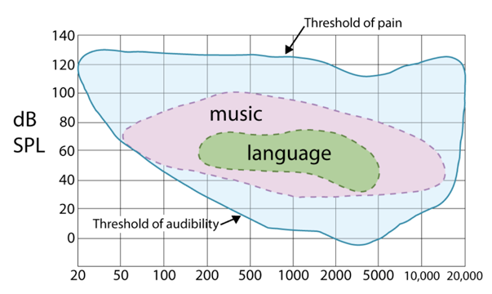
Absolute Threshold of Hearing
Absolute Threshold of Hearing - the minimum energy of a pure tone, which still allows the listener to determine the presence of this tone in the absence of ambient noise.
The dependence of this energy on frequency is shown in the figure, which also shows the pain threshold, the risk limit, as well as the areas of music and speech transmission.
Loudness and spectral regions of speech and music are different
The graphs shown are for the case of complete silence, in case of other conditions, for example, in a noisy room, the diagrams will be different.

Slide 21
Types of basic noises
In the professional literature, several different types of noise are considered.
White noise has a constant spectral density throughout the spectrum
Pink noise whose spectral density decreases by 3 dB with each successive octave
Orange noise, the spectral density of which is quasi-constant and has bands of zero energy scattered over the entire length of the spectrum; such strips are located near the frequencies corresponding to musical notes
Green noise is similar to pink noise with a boosted region around 500 Hz
Blue noise whose spectral density increases by 3 dB with each successive octave
Purple noise or differentiated white noise whose spectral density increases by 6 dB with each successive octave
Gray noise, the spectrum has a shape similar to the graph of the psychoacoustic curve of the hearing threshold
Brown noise whose spectral density decreases by 6 dB with each successive octave
Tonal noise, in the spectrum of which there are audible discrete tones
Black noise has a constant finite spectral density beyond a hearing threshold of 20 kHz.

Slide 22
Frequency (simultaneous) masking
The properties of inter-band and intra-band frequency masking are related to the mechanism of critical human hearing bands.
Masking is understood as a situation in which one sound becomes inaudible due to the presence of another sound
In order to optimally calculate the masking threshold, two types of frequency masking should be distinguished: tone-to-noise and noise-to-tone.
In the first case the tone signal located in the center of the critical band masks the noise within the bandwidth or some of its vicinity.
In the second case the noise is the masking signal, and the tone is the masked one.

Slide 23
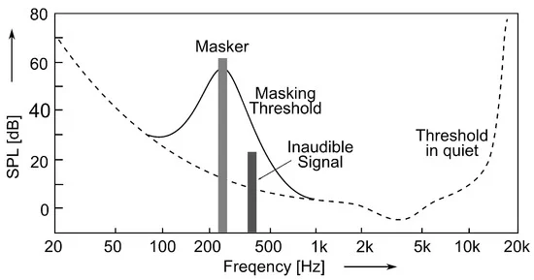
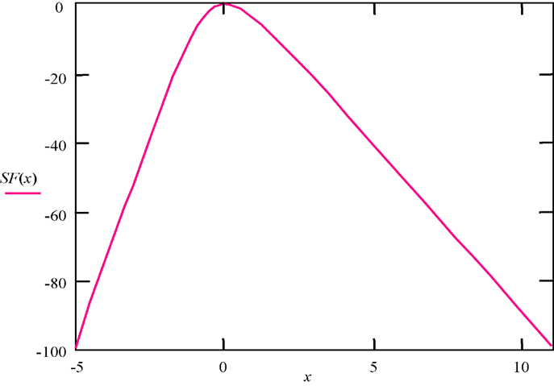
Frequency (simultaneous) masking
The masking effect can be simplistically explained by the fact that a strong tonal or noise masker creates a focus of excitation in the region of the basilar membrane corresponding to the critical band, this excitation prevents the perception of a weaker signal
The masking threshold decreases as the frequency difference between the masking and masked signals increases.
This phenomenon is called concealment spread and is often modeled in coding algorithms by a triangular spreading function (SF) with a slope of +25 and -10 dB/bark.
For a more accurate representation of the propagation function, the expression is used (x is the difference between the frequencies of the masked and masking signals in barks):

Slide 24
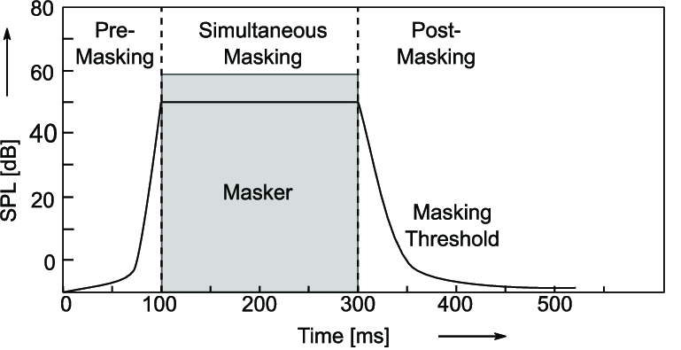
Temporal (non-simultaneous) masking
The frequency masking effect is valid for frequency components that are present in the signal spectrum at the same time.
Due to the inertia of hearing, the masking effect also spreads in the time domain
In the case where the masking tone stops before the masked tone, a post-masking effect is created.
Pre-masking is also possible, when the masking tone appears somewhat later than the masked tone.
The pre-mask interval (~ 20 ms) is significantly less than the post-mask interval (~ 50 - 300 ms)

Slide 25

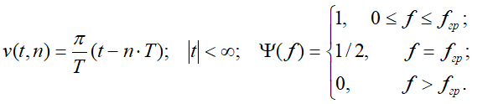
Envelope and instantaneous frequency of audio signals
According to the shape of the envelope and the change in the instantaneous frequency of the audio signals, the analysis of transient processes in the converters of acoustic energy into its electrical equivalent is carried out during processing and restoration of audio signals
The evaluation of these characteristics of audio signals is carried out using two signals: the original u(t) and the Hilbert-conjugated u_{H}(t):
Let the function u(t) be limited in spectrum by the frequency f_{gr} and be defined by discrete readings u(nT), 0 ≤ n ≤ N-1. We also assume that the interval between readings, in accordance with the Kotelnikov theorem, is determined by the relation Т = t_{n+1}-t_{n} ≤ 1/2f_{s}. Then the signal shape and its spectrum can be represented as:

Slide 26






Envelope and instantaneous frequency of audio signals
The shape of the Hilbert-transformed signal and its spectrum in this case are determined by the following relationships:
The envelope and phase change of the audio signal are calculated by the formulas:
The instantaneous frequency is determined by the phase derivative:
The derivatives of the original and Hilbert conjugate signals and their spectra are determined by the following formulas:

Slide 27
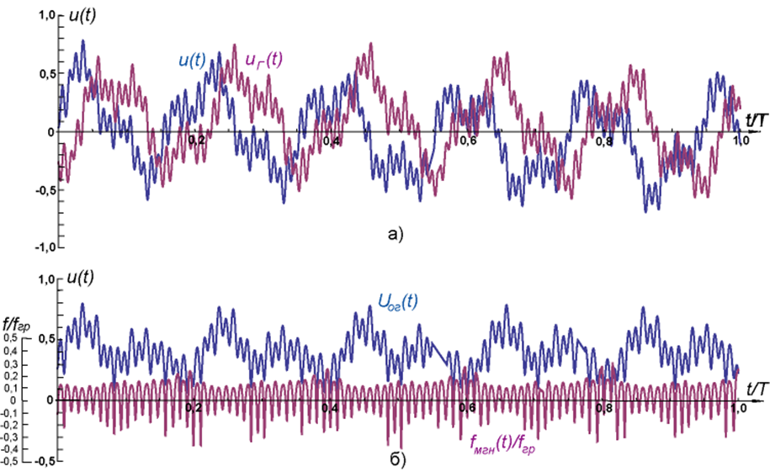

Envelope and instantaneous frequency of audio signals
As an example: blue signal consists of five cosine oscillations of various frequencies with different initial phases and simulating a small segment of speech; the Hilbert conjugate component of this signal is shown in red
Below are diagrams of the envelope of this signal (blue) and the change in instantaneous frequency (red)
If the level of the signal envelope is close to zero, then the change in the instantaneous frequency acquires a significant jump, which practically cannot be felt by ear; for this reason, when calculating the instantaneous frequency, the square of the envelope is limited to a certain value (in this case, v = 0.02)
Large bursts of the instantaneous frequency and its negative values occur in the minima of the audio signal envelope

Slide 28
Spatial perception of sound signals
The locational abilities of sound perception, the so-called binaural effect, are explained by the phase shift of sound waves, the uneven level of sound pressure in the ears, the peculiarities of the timbres of familiar sound sources and their changes.
With a stationary sound source, hearing is able to determine the direction of movement of sound waves horizontally not more than 12 degrees, and vertically - 17-20 degrees
The binaural effect is practically absent at frequencies below 300 Hz, at frequencies from 300 to 1000 Hz the phase shift of the sound waves entering the right and left ear becomes noticeable, at frequencies above 1000 Hz the phase shift becomes very small and the search for direction is carried out by comparing the sound strength coming from different directions

Slide 29
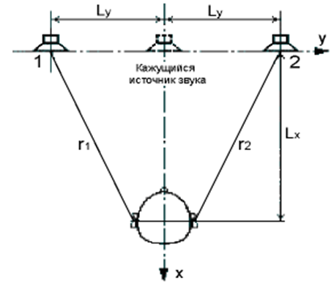
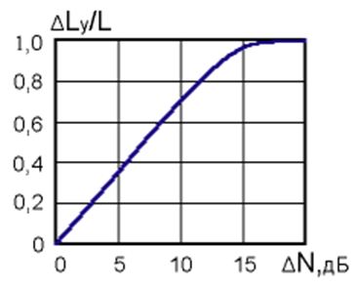
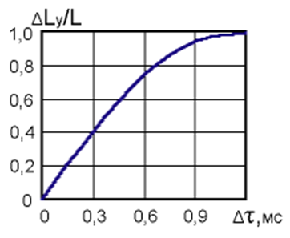
Spatial perception of sound signals
On fig. the effect of integral localization of perception of information from two sound sources is explained
Two identical sources (1 and 2) located at a distance of 2L_{y} from one another, and at a distance L_{x} is a listener whose ears are at a distance of r₁ and r₂ from the corresponding sources
If sound energy of the same power is emitted from both sources, then the sound from each source will reach the ears at the same time and the identity of the sounds will not allow hearing to separate them in space, for example, into left and right; in this case, an illusion arises: the virtual (apparent) sound source, as it were, is in the middle between the sound sources
If we reduce the power of one of the sources, then this is perceived as a displacement of the apparent source towards the second source; thus, by varying the volume of the sound of the left and right sources, it is possible to cause and maintain the illusion of moving a virtual sound source
A similar illusion of moving a virtual source arises if you create a sound delay in one of the sources
Both of these effects are widely used in digital processing and recording of music.
observed sound source

Slide 30
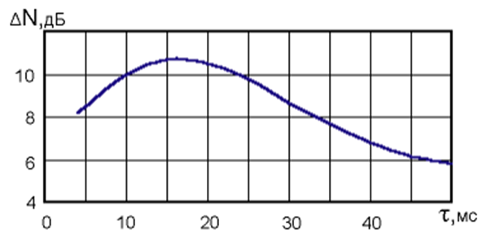
Spatial perception of sound signals
With delays more than 50 ms, the presence of a delayed signal is felt as interference in the form of an echo. The leading signal at the same level as the delayed one in this case suppresses (masks) the latter. By increasing the level of the delayed signal, it is possible to ensure that both sound sources will be perceived separately even with a delay of less than 50 ms.
The figure shows the required level rise (N, dB) of the delayed signal as a function of the time delay. At t = 15-20 ms, the level of the delayed signal must be increased by 11 dB so that both sound sources are perceived separately. At t < 50 ms, a level increase of only 6 dB is sufficient for this effect. At t < 5 ms, an unstable mode is observed: the virtual sound source, as it were, jumps from one source to another, coinciding either with the source of the leading or with the source of the delayed signal
observed sound source

Slide 31
Spatial perception of sound signals
For high-quality perception of the real spatial sound of music programs, the use of a two-channel (stereo) sound signal reproduction system is not always sufficient.
The main reason for this lies in the fact that the stereo signal coming to the listener from two physical sound sources determines the location of imaginary sources only in the plane in which the real physical sound sources are located.
Therefore, in recent decades, multichannel sound reproduction systems have been developed that implement the transural effect.
To recreate more realistic, truly surround sound, they resort to the use of complex techniques that model the features of the human auditory system, as well as the physical features and effects of the transmission of sound signals in space. The main problem is to create such a signal that, using two or more sound sources, would be perceived by the listener as three-dimensional.

